Slide 1
This is CS50

Slide 2
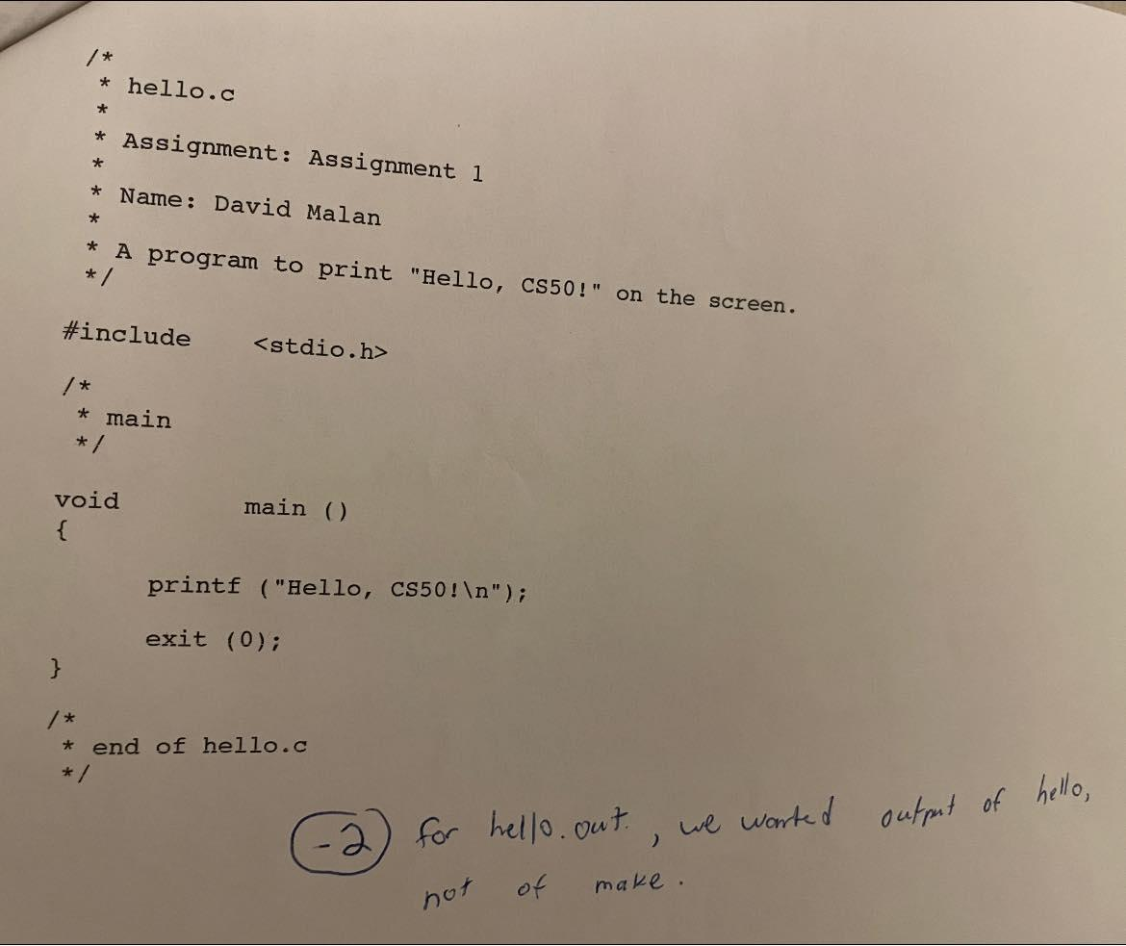

Slide 3
what ultimately matters in this course is not so much where you end up relative to your classmates but where
you end up relative to yourself when you began
Notes:
experience that matters is yours
not a competition

Slide 4
2/3
of CS50 students have never taken CS before

Slide 5
input →
→ output
Notes:
Representations: counting on hand, counting with decimal, but computers only have 0s and 1s

Slide 6
000

Slide 7
001

Slide 8
010

Slide 9
011

Slide 10
100

Slide 11
101

Slide 12
110

Slide 13
111

Slide 14
123

Slide 15
1
123

Slide 16
10
1
123

Slide 17
100
10
1
123

Slide 18
100
10
1
123
100 × 1

Slide 19
100
10
1
123
100 × 1
+
10 × 2

Slide 20
100
10
1
123
100 × 1
+
10 × 2
+
1 × 3

Slide 21
100
10
1
123
100
+
20
+
3

Slide 22
123

Slide 23
100
10
1
# # #
Notes:
But why 1, 10, and 100?

Slide 24
10²
10¹
10⁰
# # #

Slide 25
2²
2¹
2⁰
# # #

Slide 26
4
2
1
# # #

Slide 27
4
2
1
000

Slide 28
4
2
1
001

Slide 29
4
2
1
010

Slide 30
4
2
1
011

Slide 31
4
2
1
100

Slide 32
4
2
1
101

Slide 33
4
2
1
110

Slide 34
4
2
1
111

Slide 35
A

Slide 36
65

Slide 37
01000001

Slide 38
ASCII

Slide 39
... | A | B | C | D | E | F | G | H | I | ...
... | 65 | 66 | 67 | 68 | 69 | 70 | 71 | 72 | 73 | ...

Slide 40
72 | 73 | 33

Slide 41
H | I
72 | 73 | 33
Notes:
Call-on

Slide 42
H | I | !
72 | 73 | 33

Slide 43
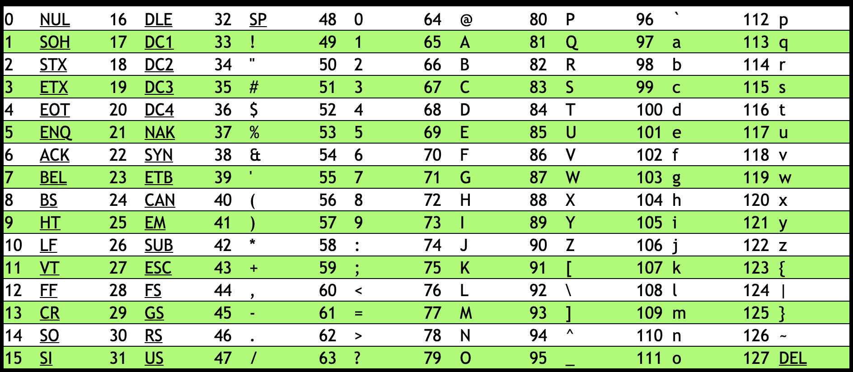
Notes:
https://asciichart.com/

Slide 44
H | I | !
72 | 73 | 33

Slide 45
H | I | !
01001000 | 01001001 | 00100001
Notes:
bytes

Slide 46
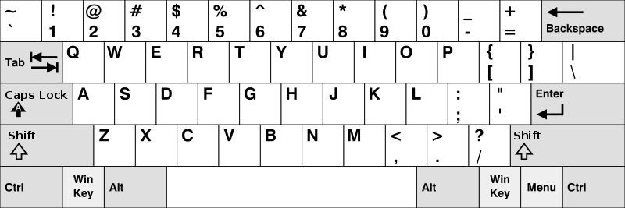
Notes:
https://en.wikipedia.org/wiki/British_and_American_keyboards
But how to represent other symbols?

Slide 47
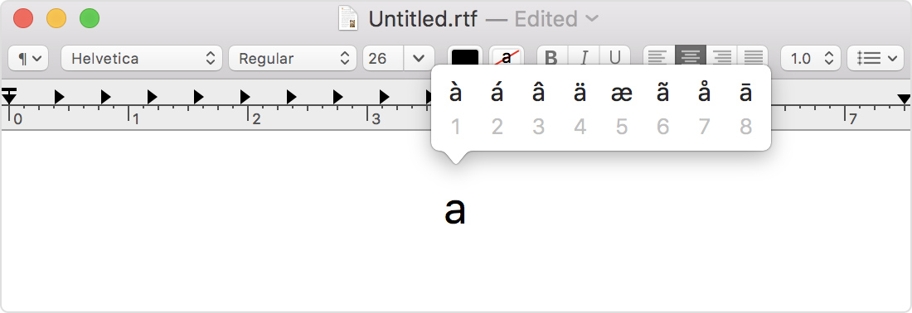
Notes:
https://support.apple.com/en-us/HT201586

Slide 48
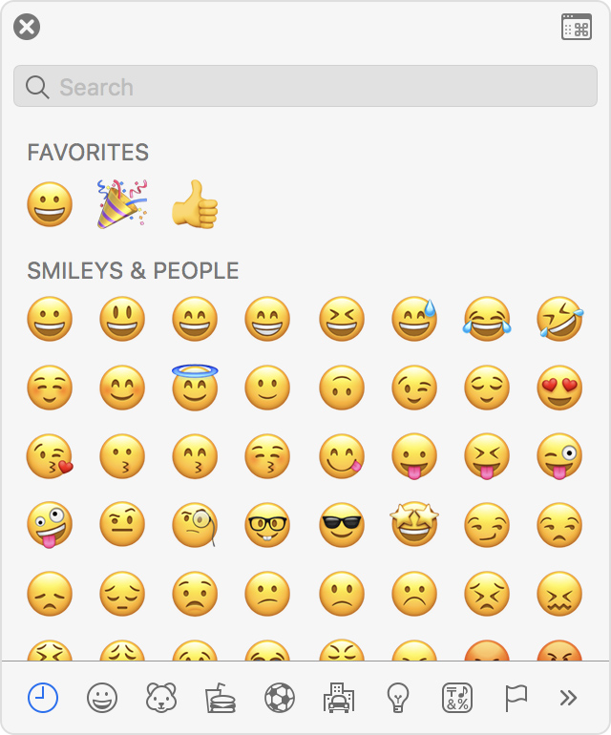
Notes:
https://support.apple.com/en-us/HT201586

Slide 49
Unicode

Slide 50
4,036,991,159

Slide 51
11110000 10011111 10011000 10110111

Slide 52

Notes:
https://emojipedia.org/face-with-medical-mask/
Google

Slide 53

Notes:
https://emojipedia.org/face-with-medical-mask/
Apple

Slide 54
Notes:
Should be #484921ff, but brightened for projectors.

Slide 55
RGB

Slide 57
72 | 73 | 33

Slide 58
72 | 73 | 33

Slide 60
Notes:
Should be #484921ff, but brightened for projectors.

Slide 61


Slide 62


Slide 63


Slide 64
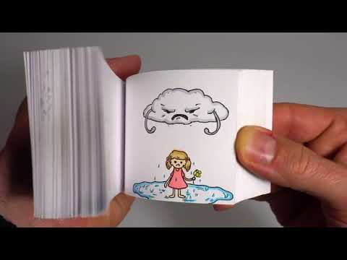
Notes:
https://youtu.be/p3q9MM__h-M

Slide 65
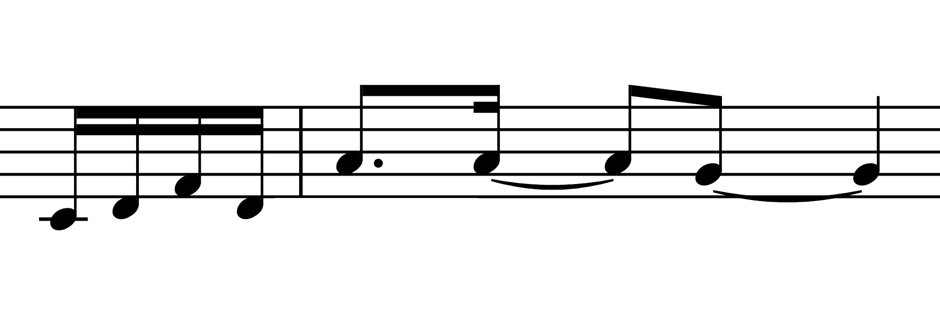
Notes:
note, duration, volume

Slide 66
144 60 64
128 60 64
144 62 64
128 62 64
144 65 64
128 65 64
144 62 64
128 62 64
144 69 64
128 69 64
144 69 64
128 69 64
144 67 64
128 67 64
Notes:
[Command byte] [Pitch byte] [Velocity/Volume byte]

Slide 67
input →
→ output

Slide 68
algorithm

Slide 69

Notes:
https://apps.apple.com/us/app/contacts/id1069512615#?platform=iphone

Slide 70
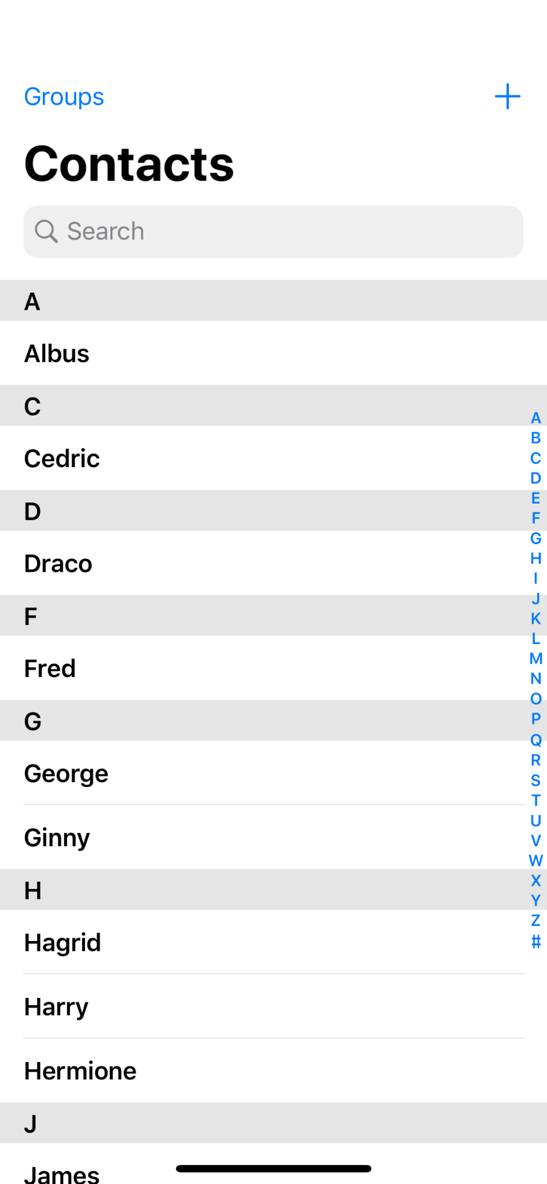

Slide 71
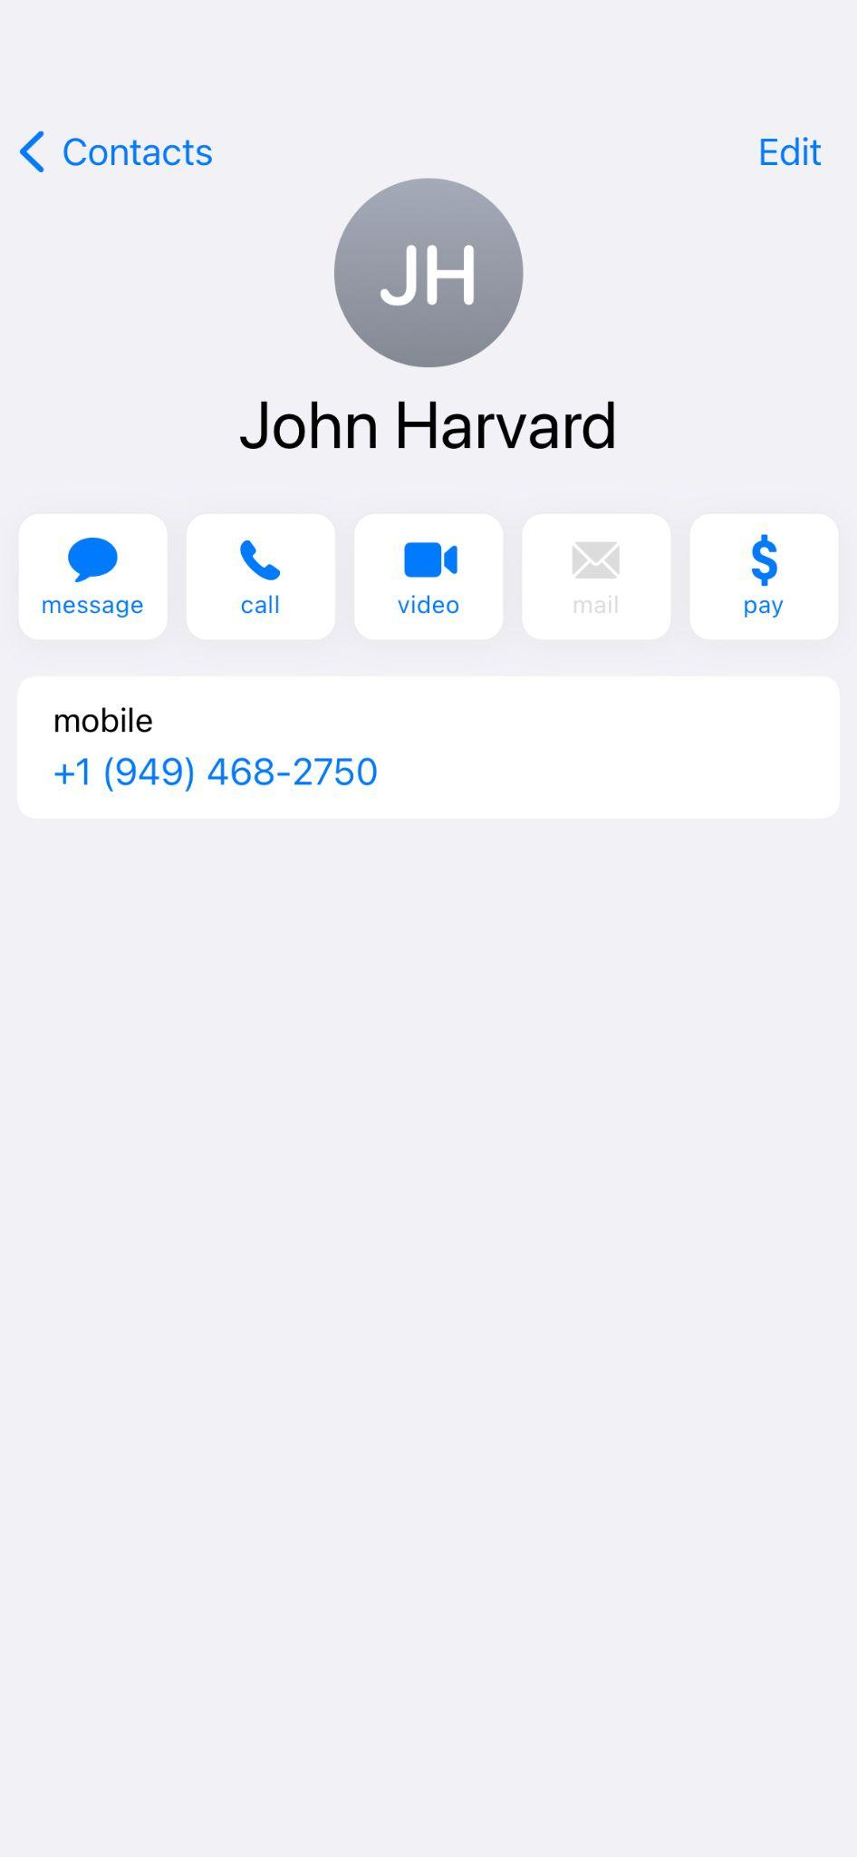

Slide 72
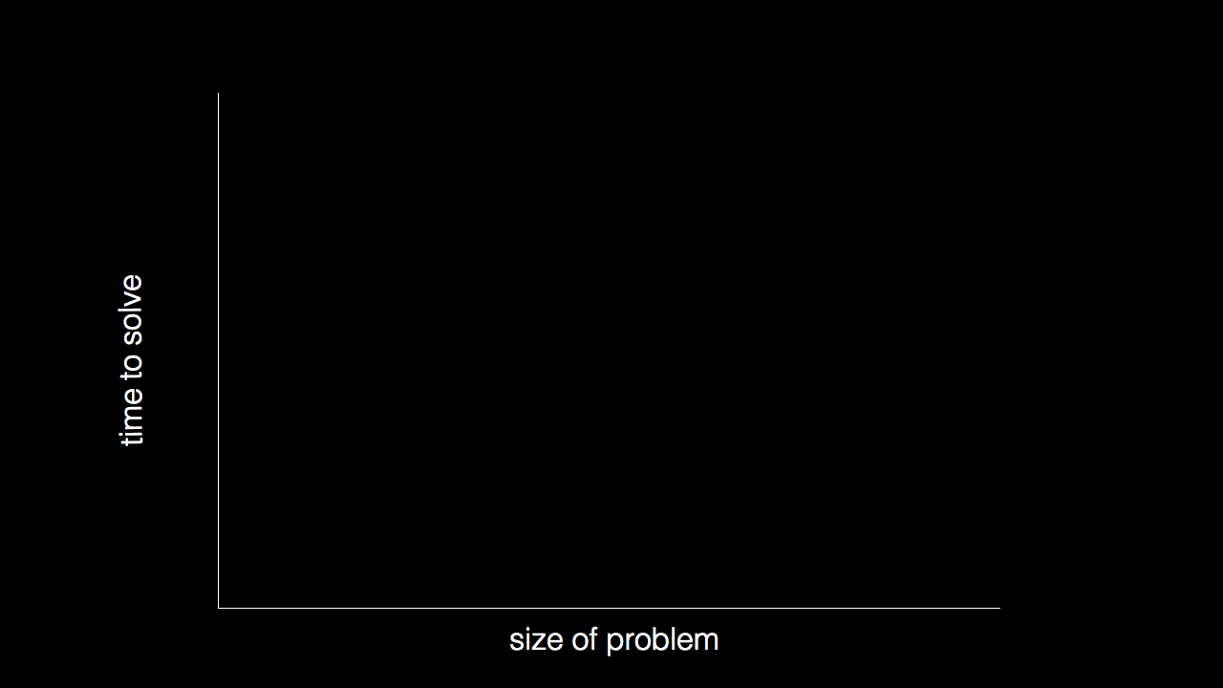

Slide 73
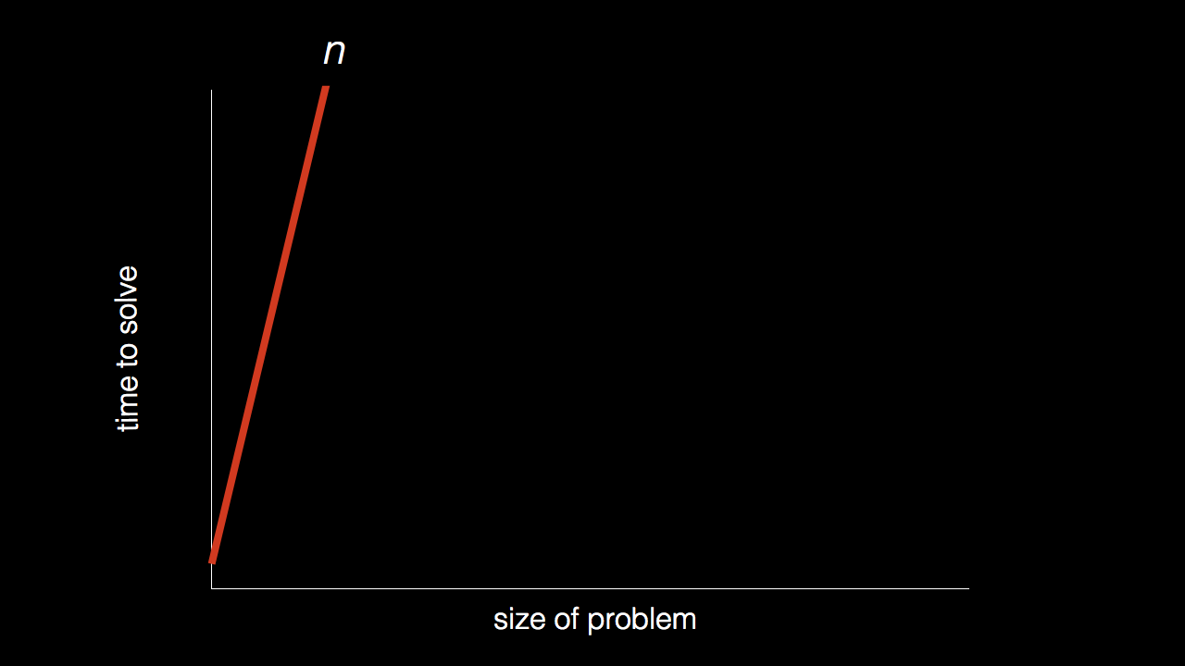
n

Slide 74
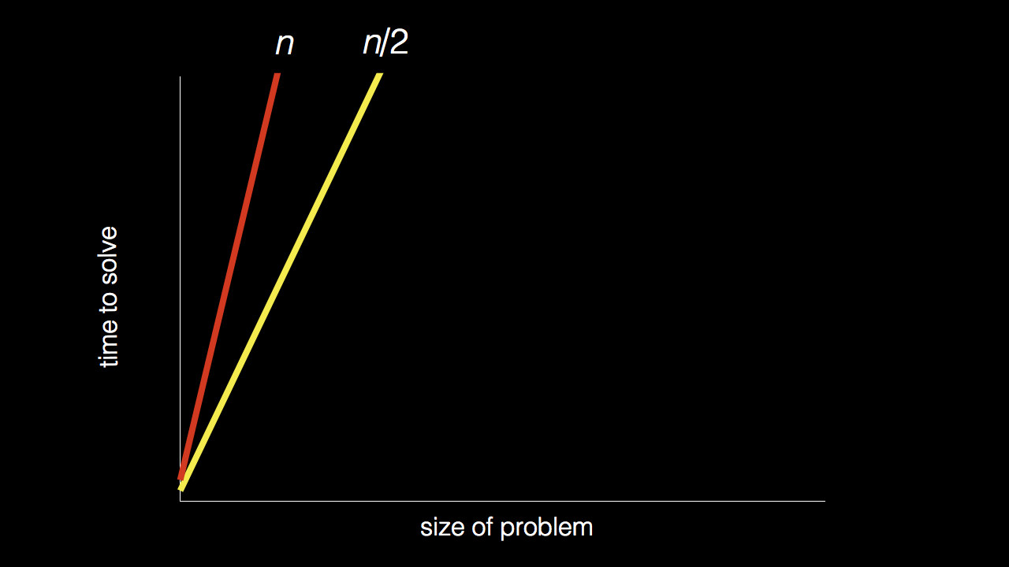
n
n/2

Slide 75
n
n/2

Slide 76
n
n/2

Slide 77
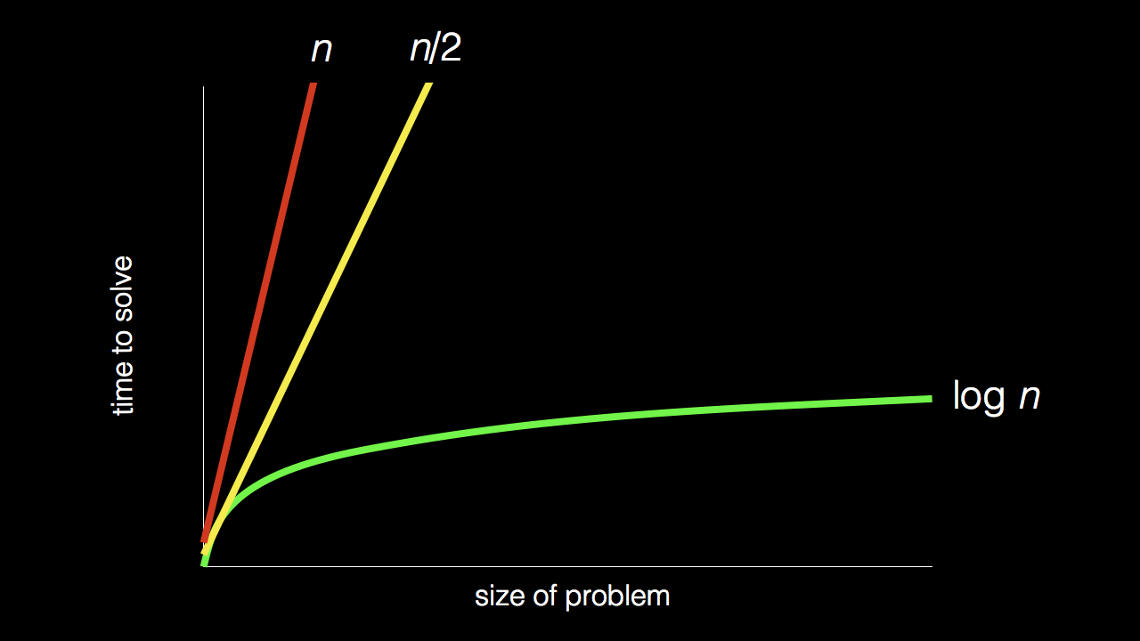
n
n/2
log₂ n

Slide 78
pseudocode

Slide 79
1 Pick up phone book
2 Open to middle of phone book
3 Look at page
4 If person is on page
5 Call person
6 Else if person is earlier in book
7 Open to middle of left half of book
8 Go back to line 3
9 Else if person is later in book
10 Open to middle of right half of book
11 Go back to line 3
12 Else
13 Quit

Slide 80
1 Pick up phone book
2 Open to middle of phone book
3 Look at page
4 If person is on page
5 Call person
6 Else if person is earlier in book
7 Open to middle of left half of book
8 Go back to line 3
9 Else if person is later in book
10 Open to middle of right half of book
11 Go back to line 3
12 Else
13 Quit

Slide 81
1 Pick up phone book
2 Open to middle of phone book
3 Look at page
4 If person is on page
5 Call person
6 Else if person is earlier in book
7 Open to middle of left half of book
8 Go back to line 3
9 Else if person is later in book
10 Open to middle of right half of book
11 Go back to line 3
12 Else
13 Quit

Slide 82
1 Pick up phone book
2 Open to middle of phone book
3 Look at page
4 If person is on page
5 Call person
6 Else if person is earlier in book
7 Open to middle of left half of book
8 Go back to line 3
9 Else if person is later in book
10 Open to middle of right half of book
11 Go back to line 3
12 Else
13 Quit

Slide 83
1 Pick up phone book
2 Open to middle of phone book
3 Look at page
4 If person is on page
5 Call person
6 Else if person is earlier in book
7 Open to middle of left half of book
8 Go back to line 3
9 Else if person is later in book
10 Open to middle of right half of book
11 Go back to line 3
12 Else
13 Quit

Slide 84
functions
arguments, return values
conditionals
Boolean expressions
loops
variables
...

Slide 85
#include <stdio.h>
int main(void) {
printf("hello, world\n");
}

Slide 86
print("hello, world")

Slide 87
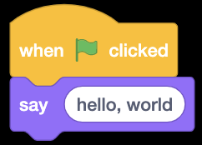
Notes:
https://scratch.mit.edu/projects/326949981/editor/

Slide 88
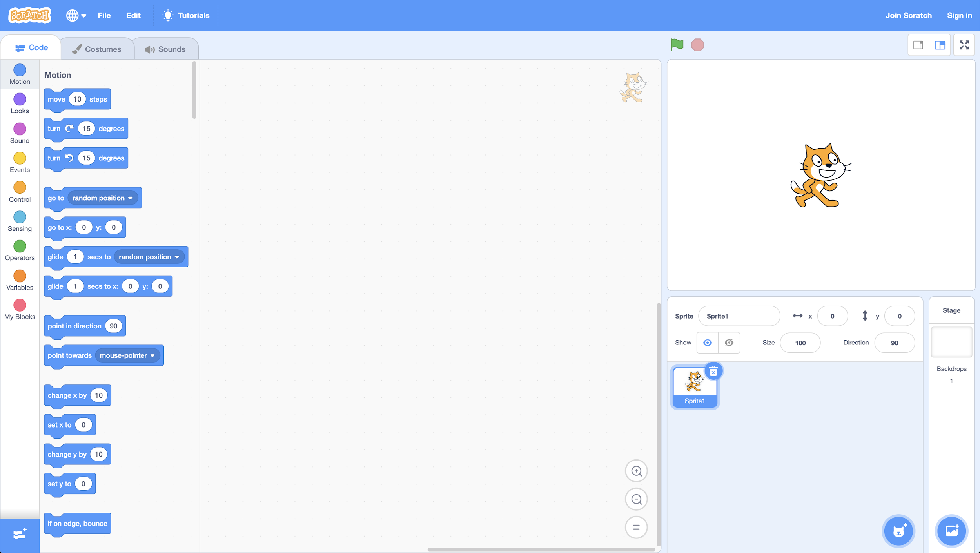

Slide 93
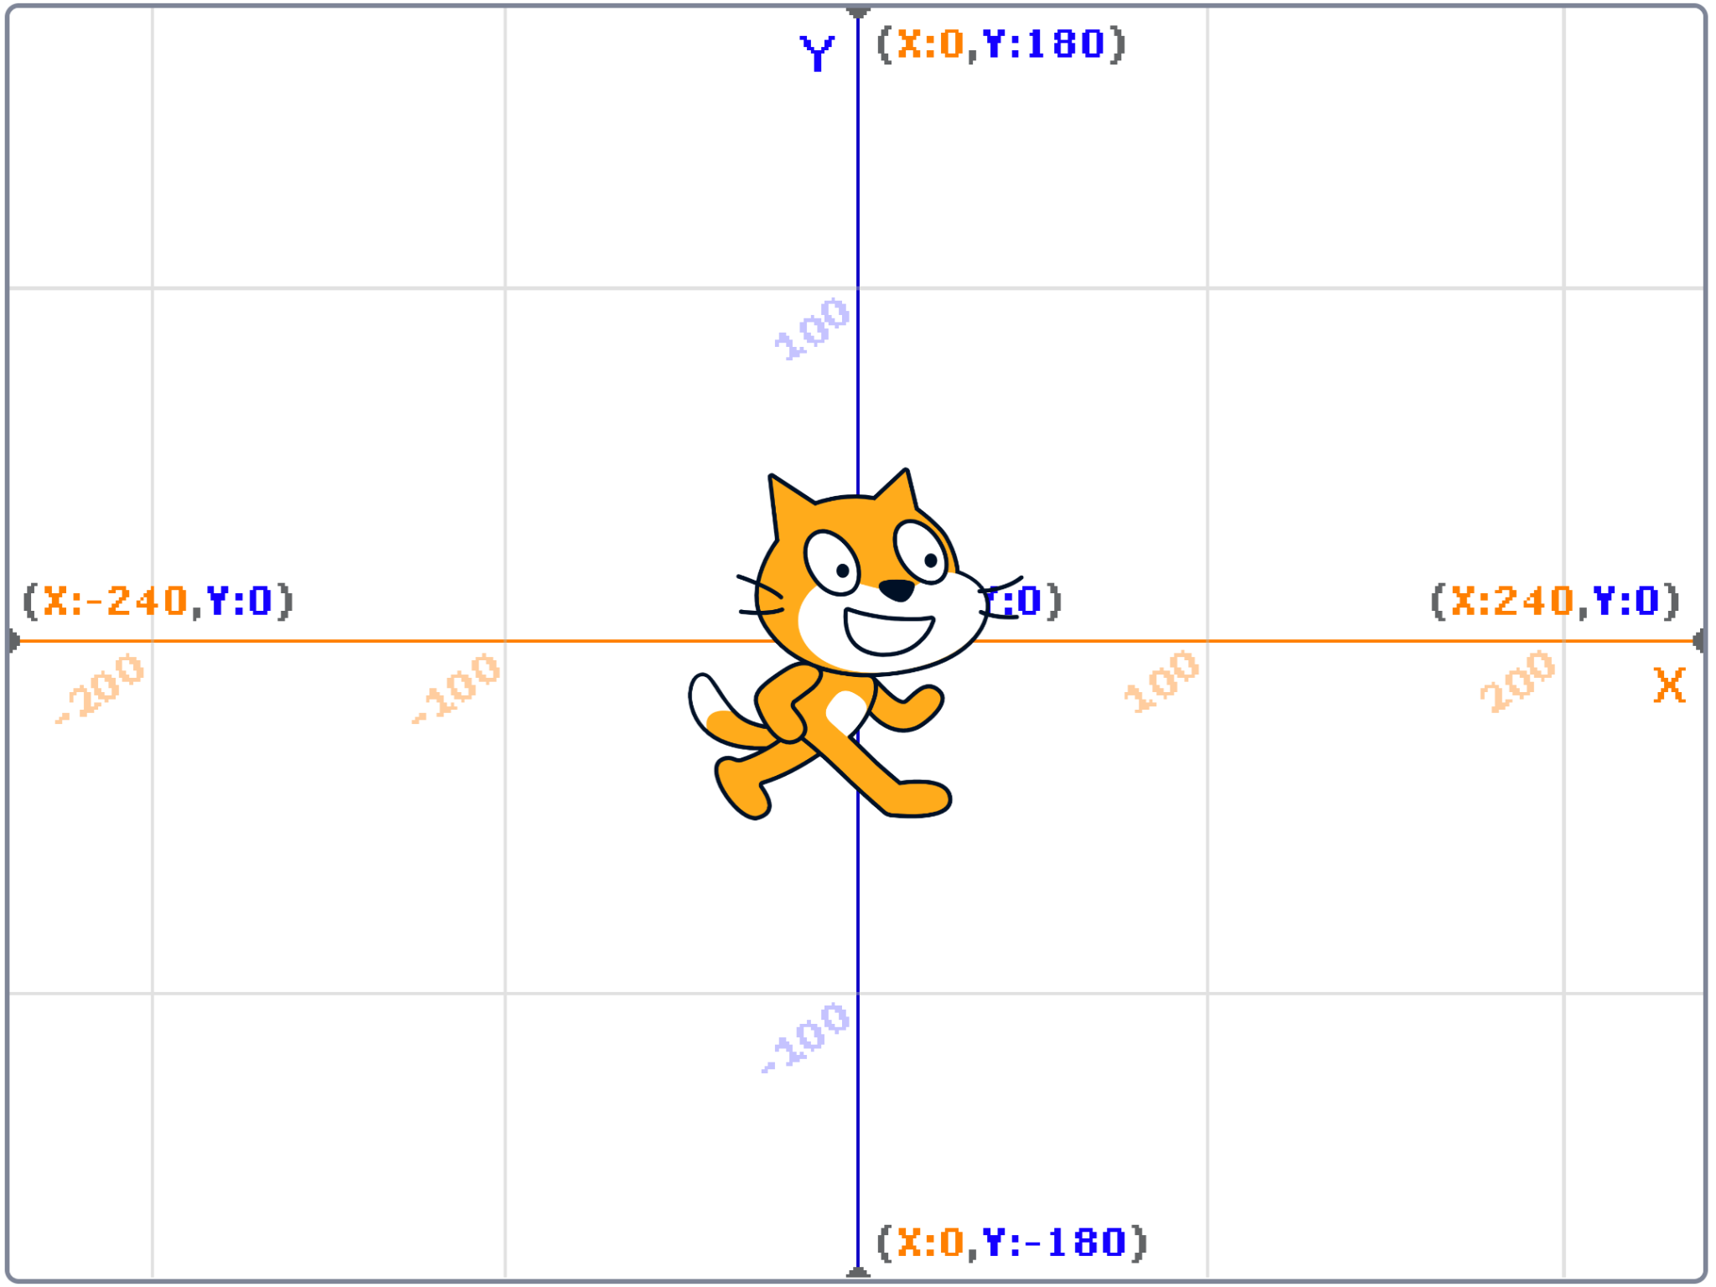

Slide 94
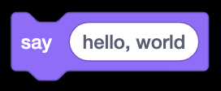
Notes:
function with argument and side effect

Slide 95
algorithm
input →
→ output

Slide 96

algorithm
→
→
→ output

Slide 97

→
→
→ output

Slide 98

→
→

Slide 99
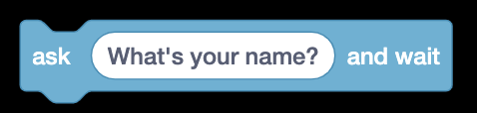
Notes:
function with argument and return value

Slide 100
algorithm
input →
→ output

Slide 101

algorithm
→
→
→ output

Slide 102
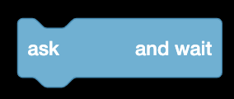
→
→
→ output

Slide 103

→
→

Slide 104
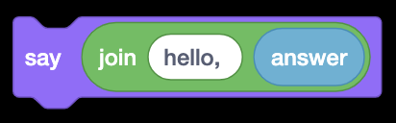
Notes:
return value from one function as argument to other function

Slide 105
algorithm
input →
→ output

Slide 106

algorithm
→
→
→ output

Slide 107

→
→
→ output

Slide 108

→
→

Slide 109
→

Slide 110
→

Slide 111
→
→

Slide 112
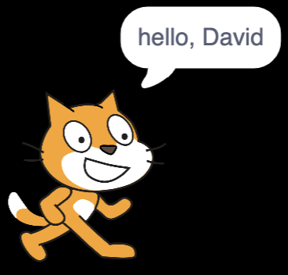
→
→
→

Slide 113


Slide 114
This is CS50

